Slide 1
Sw. Evolution: Intro & Basic Notions
D. A. Tamburri, Ph.D.

Slide 2
Sw. Evolution: Intro & Basic Notions
D. A. Tamburri

Slide 3
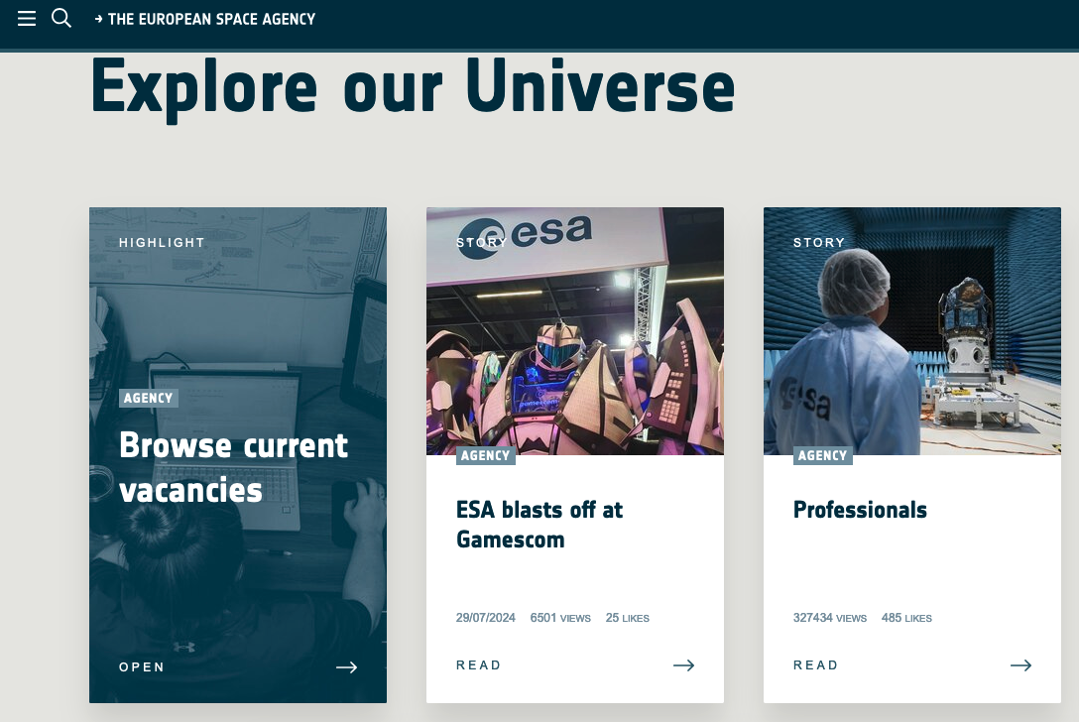


Slide 4




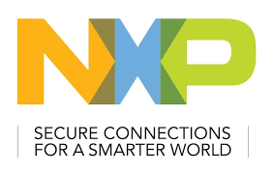

Slide 5
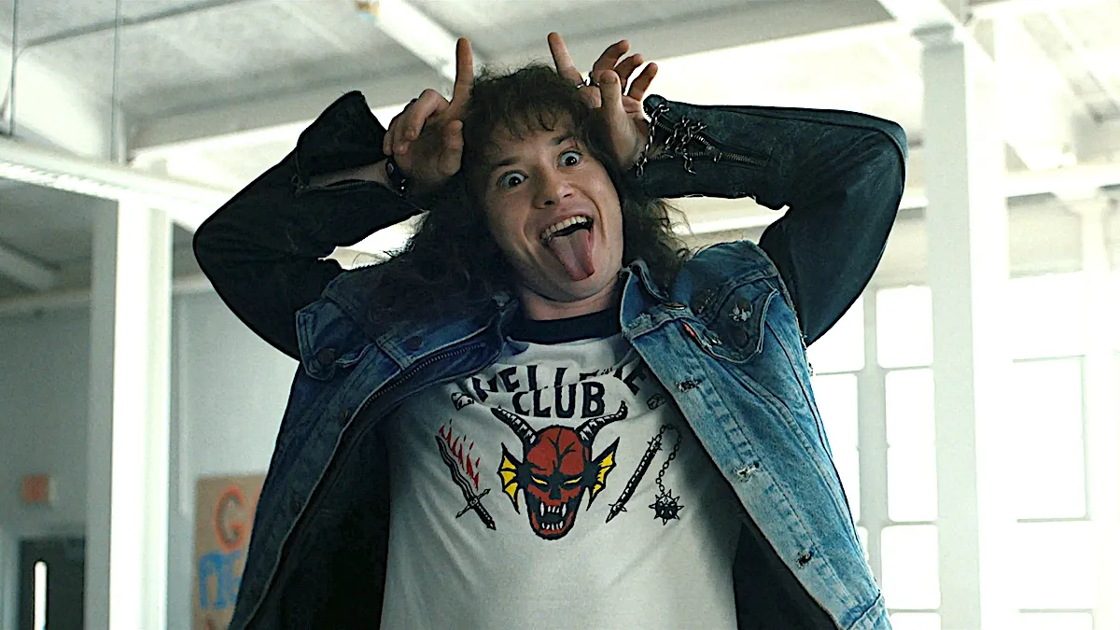
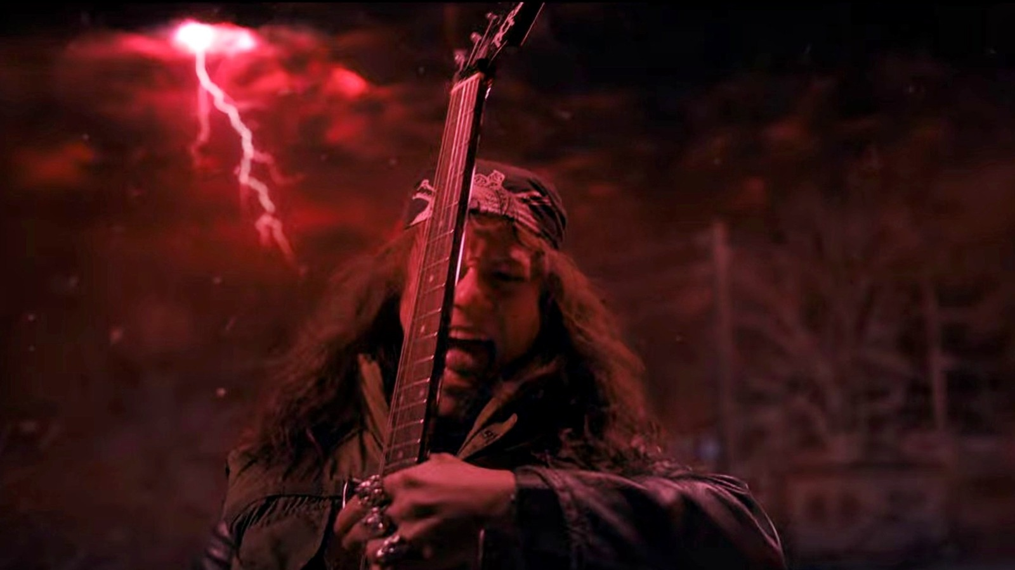
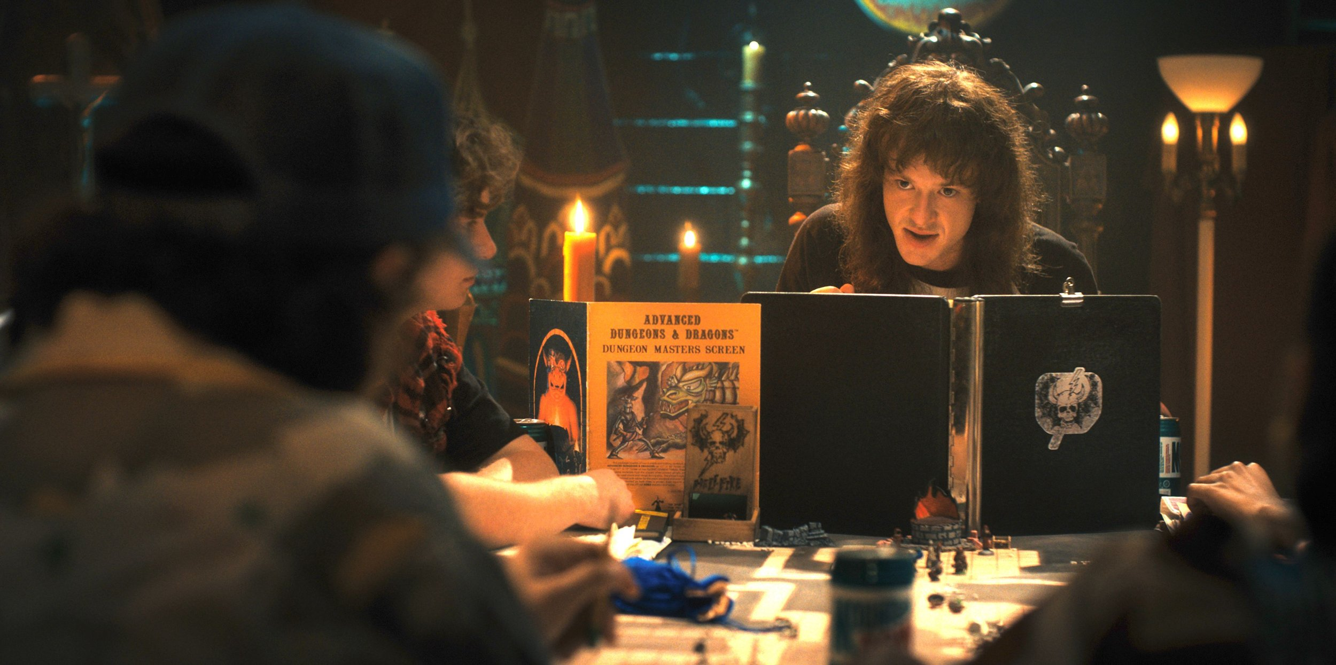

Slide 6
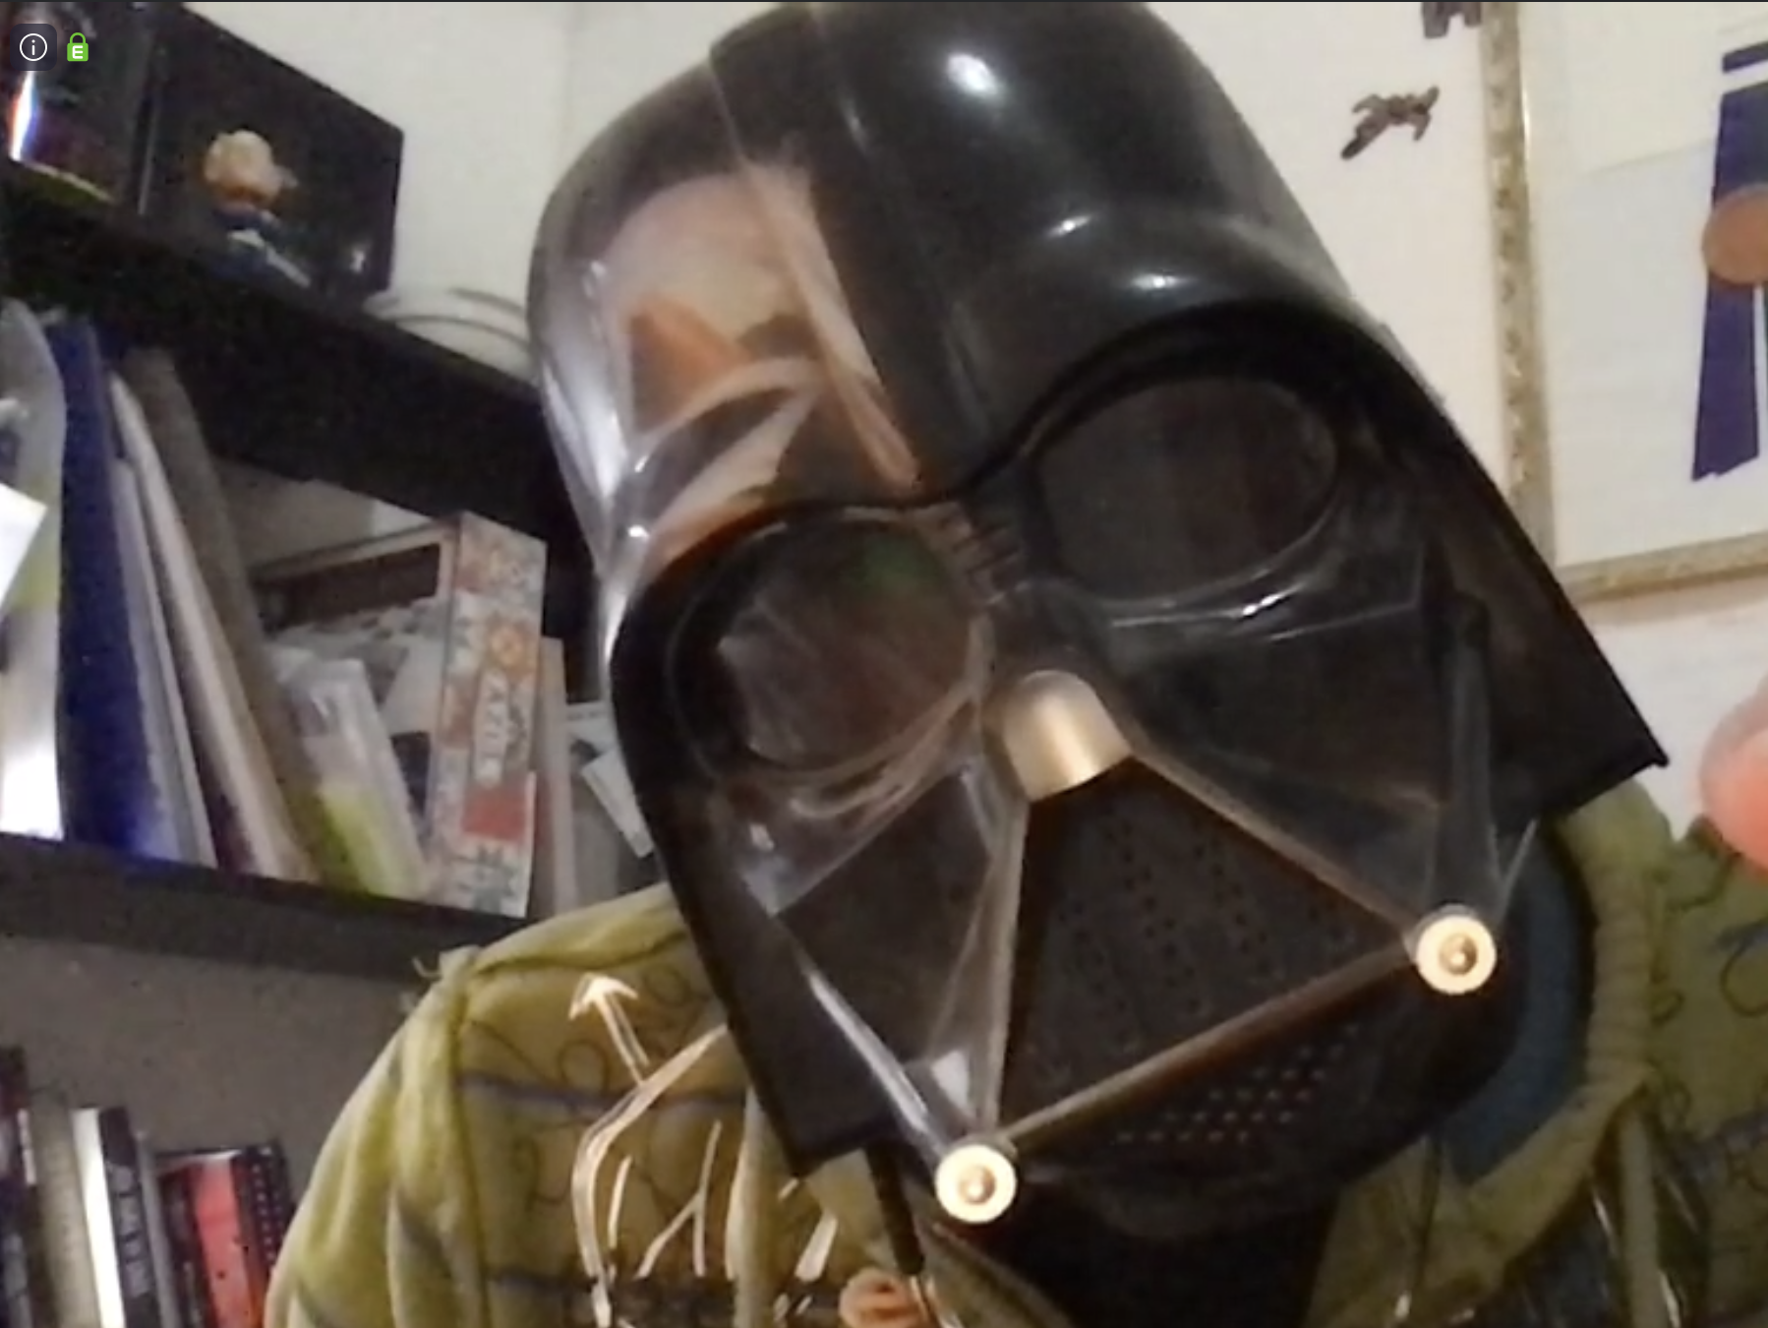
So, I know a thing or two about what I’m saying…

Slide 7
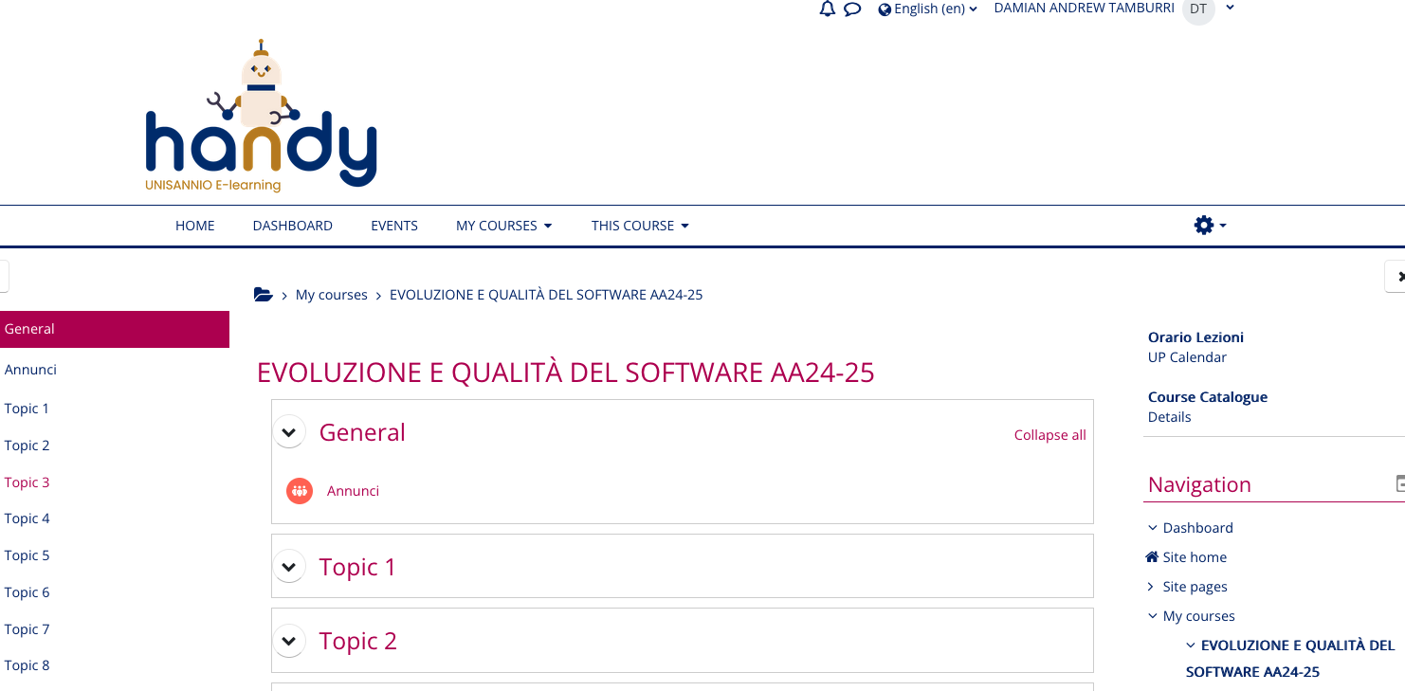

Slide 8
Part 1: Course Overview!

Slide 9
Course Structure in Blocks
Bugs
Smells
Clones
TDebt
Basics
Intro
Major Causes of Maintenance Problems
Domain & Tech. specific Maintenance & Evolution
Org. & Managerial Issues
Major Subjects of Evolution Activities
Teams
Patterns
AIOps
Smells
MLOps
IaC
µS
Req.s
Arch.s
Systems
Infra.
DevOps

Slide 10
Delivery Structure
Full-frontal Lecture (like today ☺)
Team-based project work
Flipped Classrooms:
You will do the work, but we’ll discuss it together!
Your Presentation, our Q&A Afterwards
Each team delivers at least once
Makes up 10% of total mark (up to 3 points)

Slide 11
Course Delivery Structure
Full-frontal Lecture (like today ☺)
Team-based project work
Flipped Classrooms:
You will do the work, but we’ll discuss it together!
Your Presentation, our Q&A Afterwards
Each team delivers at least once
Makes up 10% of total mark (up to 3 points)

Slide 12
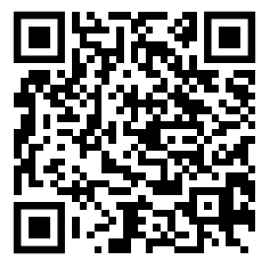
Teams’ Structure & Details
Working in teams is an essential characteristic of any sw. eng. effort, we’ll test it together as well!
Project work is major part of course evaluation!
Teams of 3 people max., enroll here: https://github.com/SannioEvolution

Slide 13
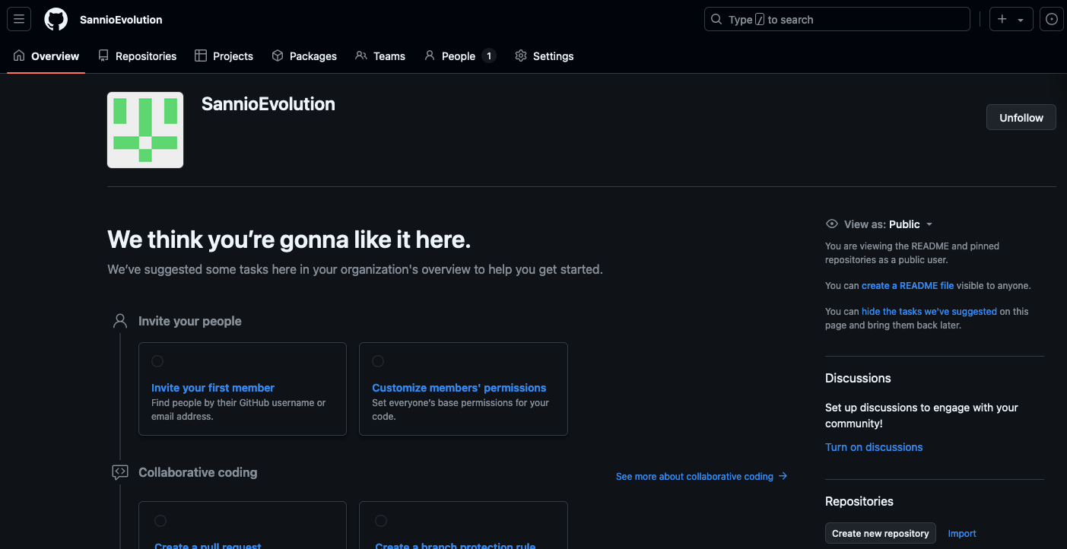

Slide 14
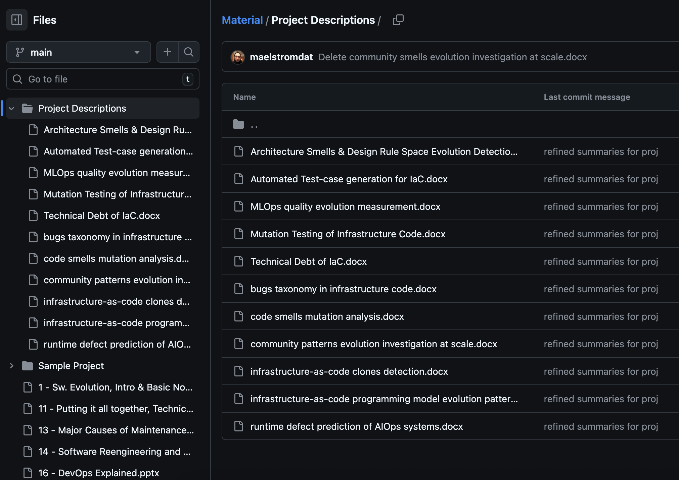

Slide 15

Grand Challenge!

Slide 16

Prize of 3000€*
Challenge in pills: Deliver an OASIS TOSCA infrastructure-code orchestrator based on Puccini and Khutulun evolved from TOSCA 1.3 to TOSCA 2.0
Shows evaluation with established evolution metrics and quality practices drawn from the course;
Offering a realistic proof-of-concept;
*probably as a scholarship

Slide 17
Project Work Specifications
Full specs available on the same site! Here’s what to do:
Form a team and enroll as above;
Study specifications, find one which appeals to you!
Investigate through it, study contents;
Ask me questions if needed…
Get started!

Slide 18
Project Work: Delivery
IEEE 2-column format (PDF)
https://www.overleaf.com/latex/templates/ieee-conference-template/grfzhhncsfqn
Max 10 pages
Must include at least
Intro to problem (with references)
Background and related work (with references)
Research/solution design
Results
Discussion
Conclusions

Slide 19
Project Work: Delivery (cont’d)
Presentation!
Must be a pitch (20 mins at most)
Focus on problems and how you solved them
Focus on eventual solution and results

Slide 20
Course Delivery Structure
Full-frontal Lecture (like today ☺)
Team-based project work
Flipped Classrooms:
You will do the work, but we’ll discuss it together!
Your Presentation, our Q&A Afterwards
Each team delivers at least once
Makes up 10% of total mark (up to 3 points)

Slide 21
9 Practicums*
Code Smell Detection
Architecture Smells Detection
Technical Debt Management
Automated Refactoring & Clone Detection in Action
AIOps & explainable orchestration in action
Monolith Decomposition in Action
MLOps comes alive with Cham3Leon (Invited Seminar!)
organizational structure detection, study, correction
Community Smells in Action
*each team, at least 1 ➔ obligatory to pass course!

Slide 22
Tool Practicum
Download/Install/configure tool
Show us!
Apply tool to no less than 10 FLOSS Projs
Show us results!
Together:
All prepare questions (after checking tool themselves)
Q&A

Slide 23
Paper Practicum
Study Through Paper Carefully
Prepare presentation/overview
Together:
All check the paper, prepare questions!
Q&A

Slide 24
First practicum due in ~2 weeks!
Study the overview at slide 19
Form a team ASAP!
“volunteer” for a practicum (mark your subj. online)!
We will check out 2 teams per each practicum session
EVERY TEAM NEEDS TO DO IT. THERE’S NO ESCAPE.

Slide 25
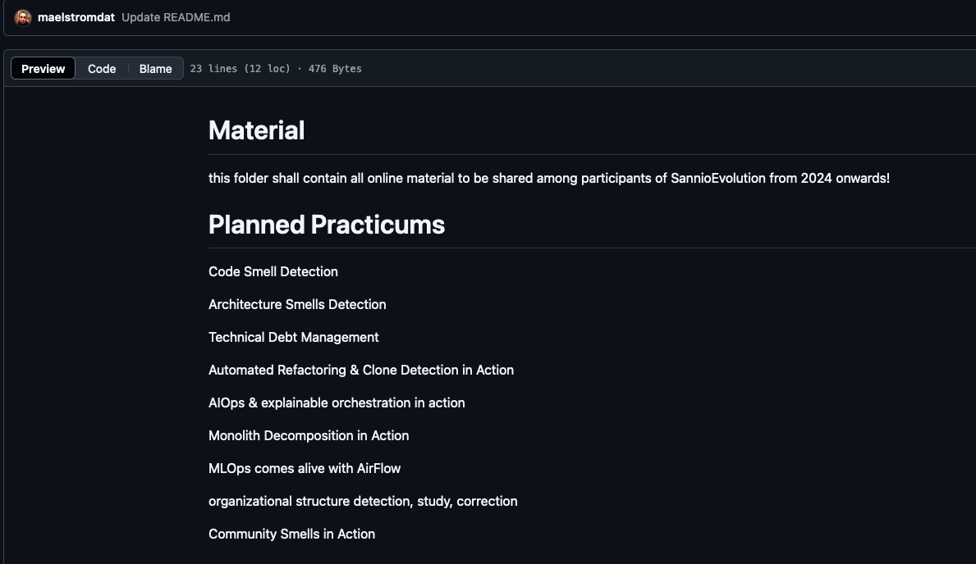

Slide 27
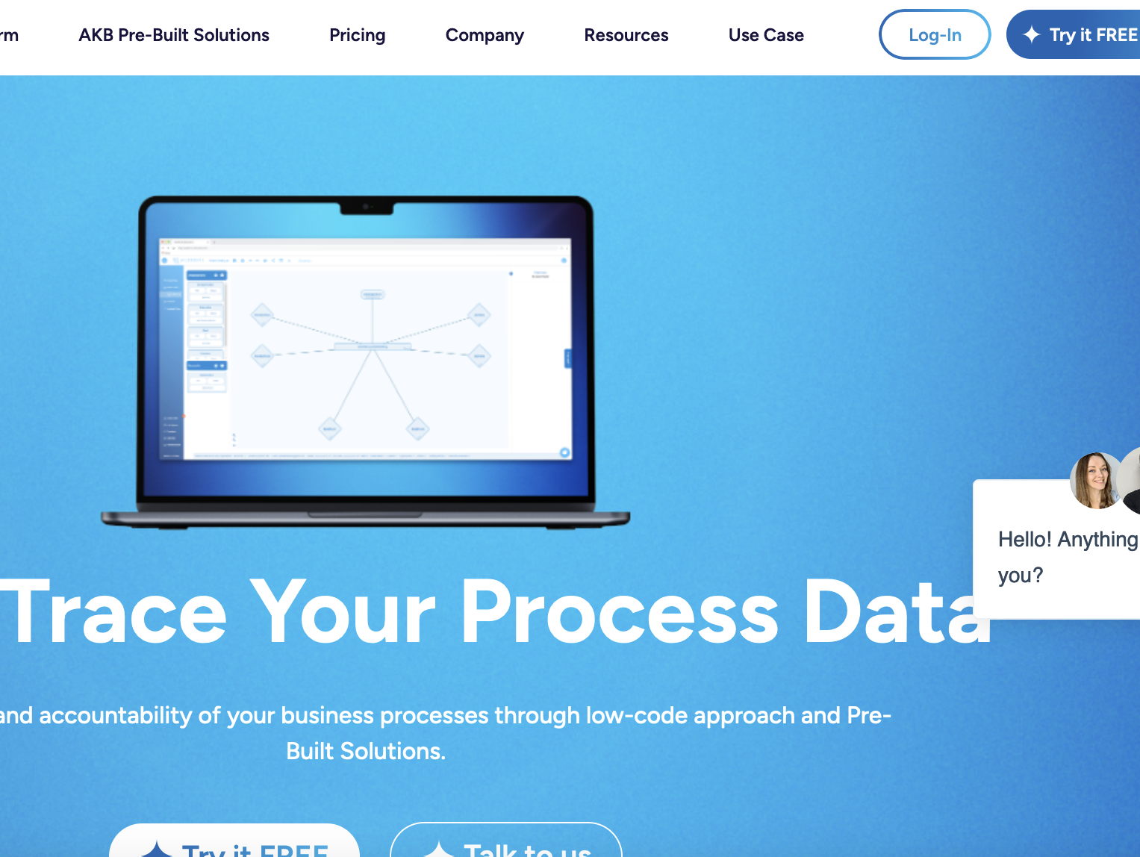

Slide 28
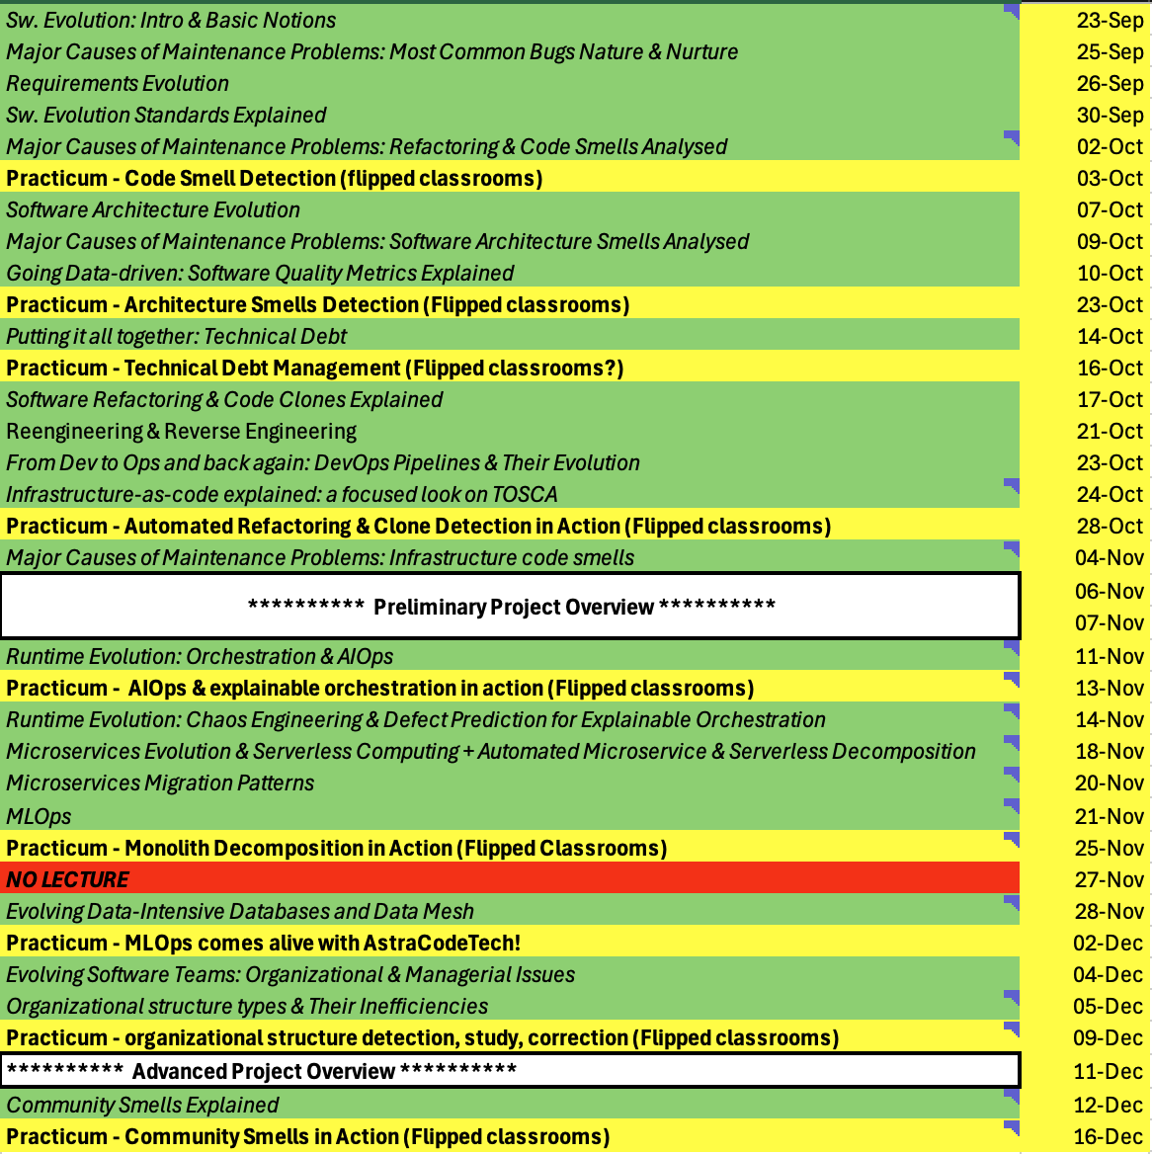

Slide 29
Might be an afternoon!

Slide 30
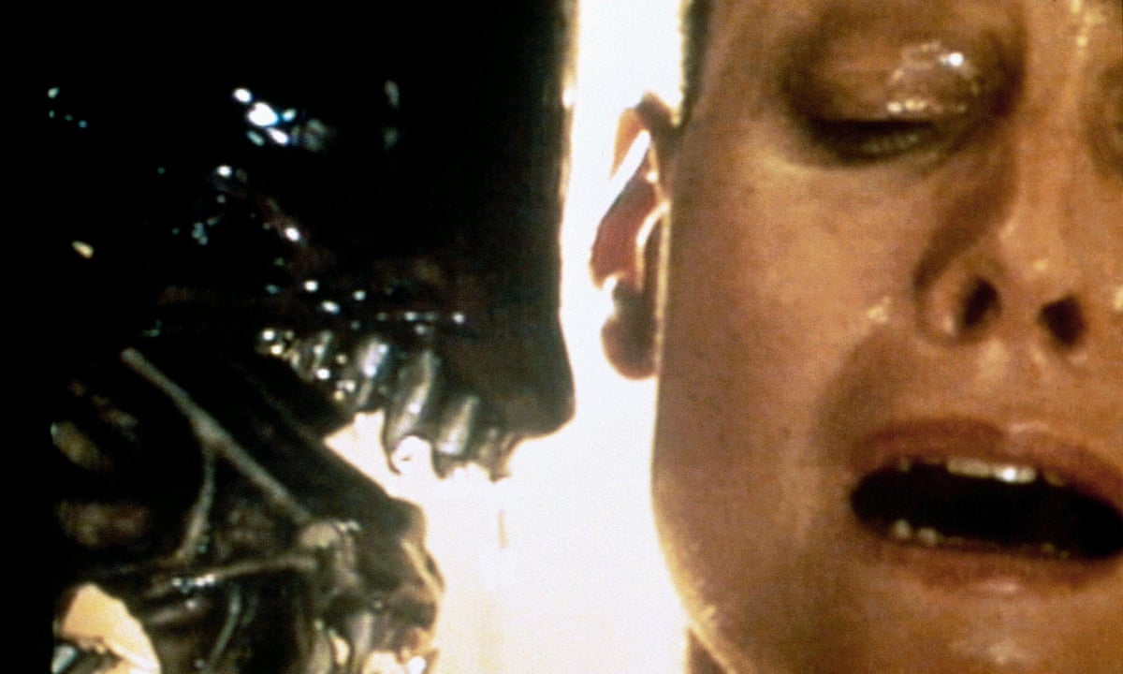
EVERY TEAM NEEDS TO DO IT. THERE’S NO ESCAPE.

Slide 31
Part 2: Intro & Basic Notions

Slide 32
Outline
- Evolution versus Maintenance
-- Software Evolution
-- Software Maintenance
Software Evolution Models and Processes
Reengineering
- Legacy Systems
- Impact Analysis
-- Refactoring
-- Program Comprehension
-- Software Reuse

Slide 33
Evolution Versus Maintenance
The terms evolution and maintenance are used interchangeably.
However, there is a semantic difference.
Lowell Jay Arthur distinguishes the two terms as follows:
“Software maintenance means to preserve from failure or decline.”
“Software evolution means a continuous change from lesser, simpler, or worse state to a higher or better state.”
Keith H. Bennett and Lie Xu use the term:
“maintenance for all post-delivery support and evolution to those driven by changes in requirements.”

Slide 34
Evolution Versus Maintenance
Maintenance is a set of planned activities whereas evolution concern whatever happens to a system over time.
Mehdi Jazayeri’s view on software evolution:
“Over time what evolves is not the software but our knowledge about a particular type of software” Cit.

Slide 35
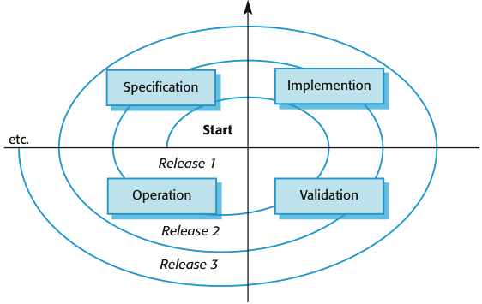

Slide 36
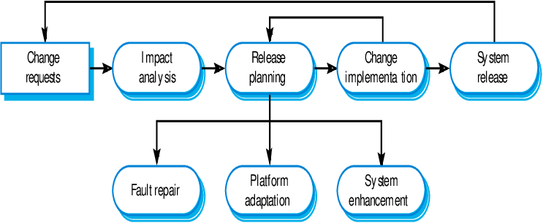
A more modern look…

Slide 37
Software Evolution
In 1965, Mark Halpern used the term evolution to define the dynamic growth of software.
The term evolution in relation to application systems took gradually in the 1970s.
Lehman and his collaborators from IBM are generally credited with pioneering the research field of software evolution.
Lehman formulated a set of observations that he called laws of evolution.
These laws are the results of studies of the evolution of large-scale proprietary or closed source system (CSS).
The laws concern what Lehman called E-type systems:
“Monolithic systems produced by a team within an organization that solve a real world problem and have human users.”

Slide 38
Software Evolution: Laws of Lehman
Continuing change (1st) – A system will become progressively less satisfying to its user over time, unless it is continually adapted to meet new needs.
Increasing complexity (2nd) – A system will become progressively more complex, unless work is done to explicitly reduce the complexity.
Self-regulation (3rd) – The process of software evolution is self regulating with respect to the distributions of the products and process artifacts that are produced.
Conservation of organizational stability (4th) – The average effective global activity rate on an evolving system does not change over time, that is the average amount of work that goes into each release is about the same.

Slide 39
Software Evolution: Laws of Lehman
Conservation of familiarity (5th) – The amount of new content in each successive release of a system tends to stay constant or decrease over time.
Continuing growth (6th) – The amount of functionality in a system will increase over time, in order to please its users.
Declining quality (7th) – A system will be perceived as losing quality over time, unless its design is carefully maintained and adapted to new operational constraints.
Feedback system (8th) – Successfully evolving a software system requires recognition that the development process is a multi-loop, multi-agent, multi-level feedback system.

Slide 40
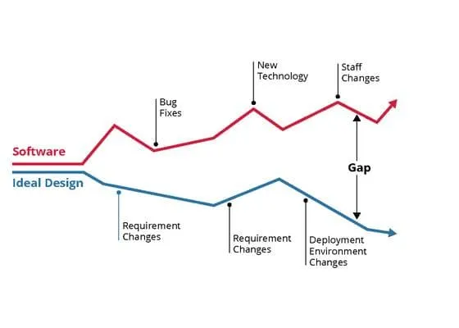
Software Evolution

Slide 41
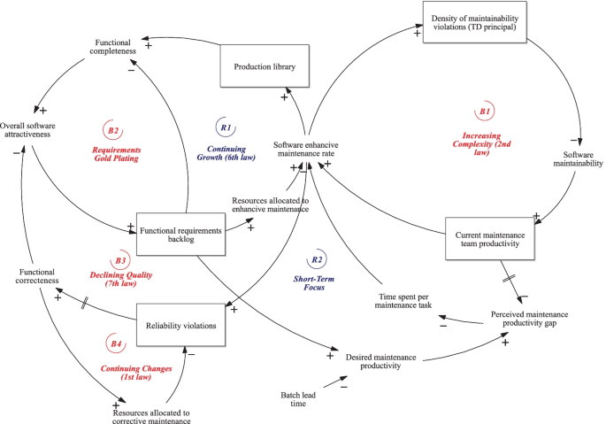
Notes:
https://link.springer.com/article/10.1007/s11219-022-09600-6

Slide 42
For Example: FOSS Systems!
In circa 1988, Pirzada pointed out the differences between the evolution of the Unix OS and system studied by Lehman
Pirzada argued that the differences in academic and industrial s/w development could lead to a differences in the evolutionary pattern.
In circa 2000, empirical study of free and open-source software (FOSS) evolution was conducted by Godfrey and Tu.
Growth trends from 1994-1999 for the evolution of FOSS Lunix OS to be super-linear, that is greater than linear.
Robles and his collaborators concluded that Lehman’s laws, 3, 4, and 5 are not fitted to large scale FOSS system such as Linux.
“FOSS is made available to the general public with either relaxed or non-existent intellectual property restrictions. The free emphasizes the freedom to modify and redistribute under the terms of the original license while open emphasizes the accessibility to the source code.”

Slide 43
Software Maintenance
There will always be defects in the delivered software application because software defect removal and quality control are not perfect.
Software maintenance is needed to repair these defects in the released software.
Burton Swanson defined three types of software maintenance:
Corrective, Adaptive & Perfective.
Based on the intent of the developer towards the system.

Slide 44
Software Maintenance
Swanson definition was later updated in the standard for software engineering – ISO/IEC 14764.
Introduced a fourth category called preventive maintenance.
Some researchers and developers view preventive maintenance as a subset of perfective maintenance.

Slide 45
Software Maintenance
Kitchenham described maintenance modifications in a hierarchical ways based on the concept of activity:
Activities to make corrections: If there are discrepancies between the expected behavior of a system and the actual behavior, then some activities are performed to eliminate or reduce the discrepancies.
Activities to make enhancements: Several activities are performed to implement a change to the system, thereby changing the behavior or implementation of the system.
This category is subdivided into three types:
enhancements that change existing requirement,
enhancements that add new system requirements, and
enhancements that change the implementation but not the requirements.

Slide 46
Software Maintenance
Chapin et al. expanded the typology of Swanson into an evidence-based classification of 12 different types of software maintenance:
Training
Evaluate
Updative
Preventive
Adaptive
Corrective
Consultive
Reformative
Groomative
Performance
Reductive
Enhancive

Slide 47
Software Maintenance: COTS
The major differences between component-based software systems (CBS) and custom-built software systems:
Skills of system maintenance teams.
Infrastructure and organization.
COTS maintenance cost.
Larger user community.
Modernization.
Split maintenance function.
More complex planning.

Slide 48
Software Evolution Models and Processes
Software maintenance have its own software maintenance life cycle (SMLC) model.
Three popular SMLC models (examples):
Staged model of maintenance and evolution.
Iterative models.
Change mini-cycle models.

Slide 49
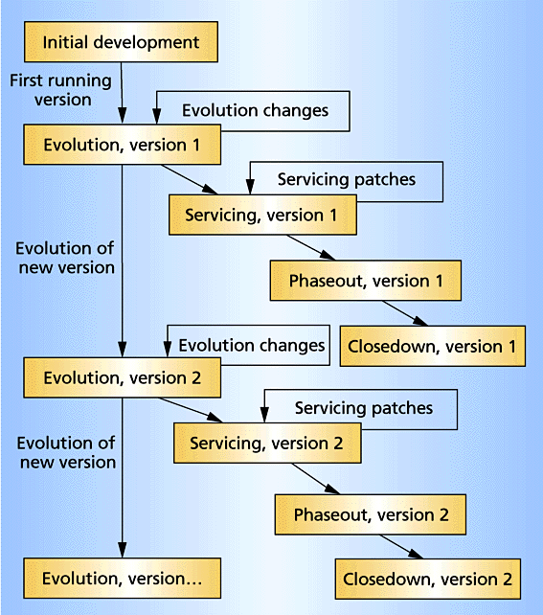

Slide 50
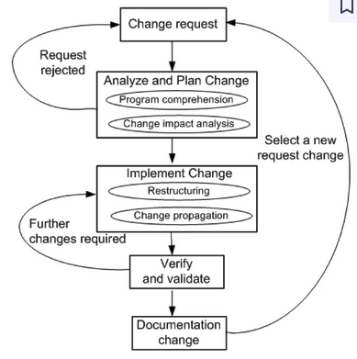

Slide 51
Software Evolution Models and Processes
Software Maintenance Standards
IEEE and ISO have both addressed s/w maintenance processes.
IEEE/EIA 1219 and ISO/IEC 14764 as a part of ISO/IEC12207 (life cycle process).
IEEE/EIA 1219 organizes the maintenance process in seven phases:
problem identification, analysis, design, implementation, system test, acceptance test and delivery.
ISO/IEC 14764 describes s/w maintenance as an iterative process for managing and executing software maintenance activities.
The activities which comprise the maintenance process are:
process implementation, problem and modification analysis, modification implementation, maintenance review/acceptance, migration and retirement.
Each of these maintenance activity is made up of tasks. Each task describes a specific action with inputs and outputs.

Slide 52
Software Evolution Models and Processes
Software Maintenance Standards
IEEE and ISO have both addressed s/w maintenance processes.
IEEE/EIA 1219 and ISO/IEC 14764 as a part of ISO/IEC12207 (life cycle process).
IEEE/EIA 1219 organizes the maintenance process in seven phases:
problem identification, analysis, design, implementation, system test, acceptance test and delivery.
ISO/IEC 14764 describes s/w maintenance as an iterative process for managing and executing software maintenance activities.
The activities which comprise the maintenance process are:
process implementation, problem and modification analysis, modification implementation, maintenance review/acceptance, migration and retirement.
Each of these maintenance activity is made up of tasks. Each task describes a specific action with inputs and outputs.

Slide 53
Software Evolution Models and Processes
Software Configuration Management
SCM is the discipline of managing and controlling change in the evolution of software system.
It ensures that the released software is not contaminated by uncontrolled or unapproved changes.
An SCM system has four different elements, each element addressing a distinct user need as follows:
Identification of software configurations.
Control of software configurations.
Auditing software configurations.
Accounting software configuration status.

Slide 54
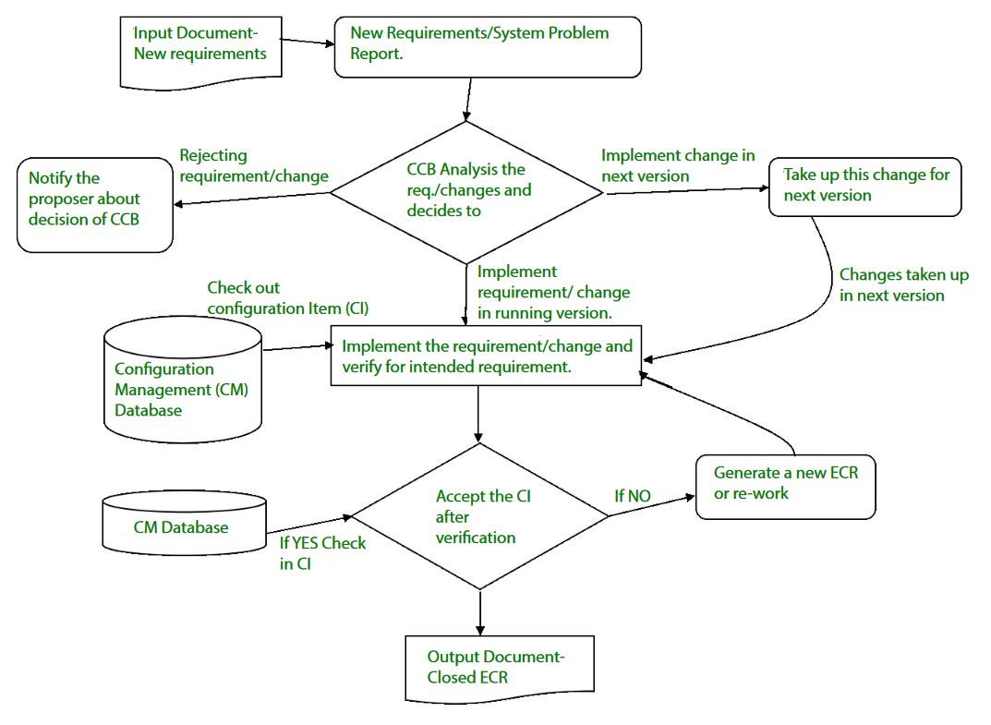

Slide 55
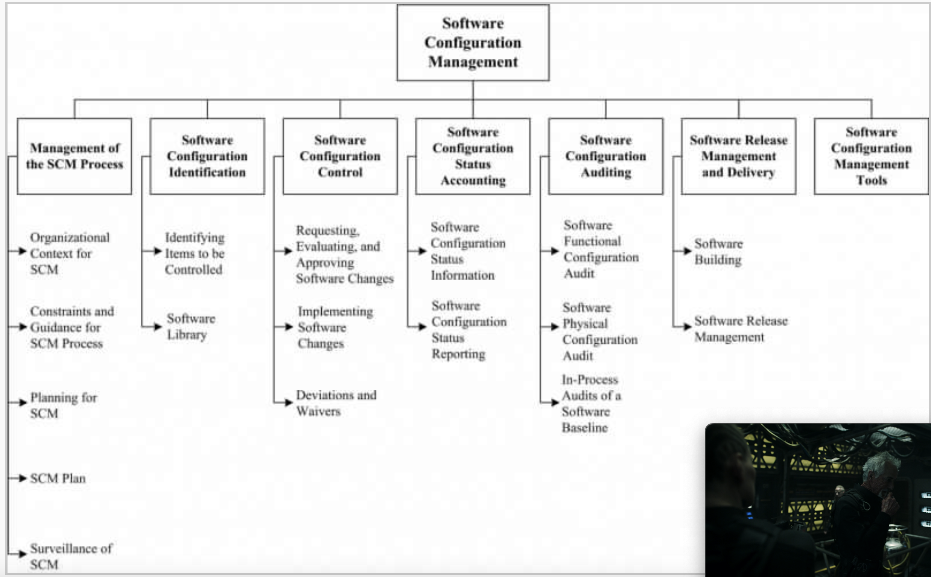

Slide 56
Reengineering
Reengineering is done to transform an existing “lesser or simpler” system into a new “better” system.
Reengineering is the examination, analysis and restructuring of an existing software system to reconstitute it in a new form, and the subsequent implementation of the new form.
Chikofsky and Cross II defines reengineering as:
“the examination and alteration of a subject system to reconstitute it in a new form and the subsequent implementation of the new form.”

Slide 57
Reengineering
Jacobson and Lindstorm defined following formula:
Reengineering = Reverse engineering + + Forward engineering.
Reverse engineering is the activity of defining a more abstract, and easier to understand, representation of the system
The core of reverse engineering is the process of examination, not a process of change, therefore it does not involve changing the software under examination.
The third element “forward engineering,” is the traditional process of moving from high-level abstraction and logical, implementation-independent designs to the physical implementation of the system.
The second element captures alteration that is change of the system.

Slide 58
Legacy System
A system is an old asset which is valuable for the company which often developed and owns it.
It is the phase out stage of the software evolution model of Rajlich and Bennet described earlier.
Bennett used the following definition:
“large software systems that we don’t know how to cope with but that are vital to our organization.”
Similarly, Brodie and Stonebraker: define a legacy system as
“any information system that significantly resists modification and evolution to meet new and constantly changing business requirements.”

Slide 59
Legacy System
There are a number of options available to manage legacy systems. Typical solution include:
Freeze: The organization decides no further work on the legacy system should be performed.
Outsource: An organization may decide that supporting software is not core business, and may outsource it to a specialist organization offering this service.
Carry on maintenance: Despite all the problems of support, the organization decides to carry on maintenance for another period.
Discard and redevelop: Throw all the software away and redevelop the application once again from scratch.
Wrap: It is a black-box modernization technique – surrounds the legacy system with a software layer that hides the unwanted complexity of the existing data, individual programs, application systems, and interfaces with the new interfaces.
Migrate: Legacy system migration basically moves an existing, operational system to a new platform, retaining the legacy system’s functionality and causing minimal disruption to the existing operational business environment as possible.

Slide 60
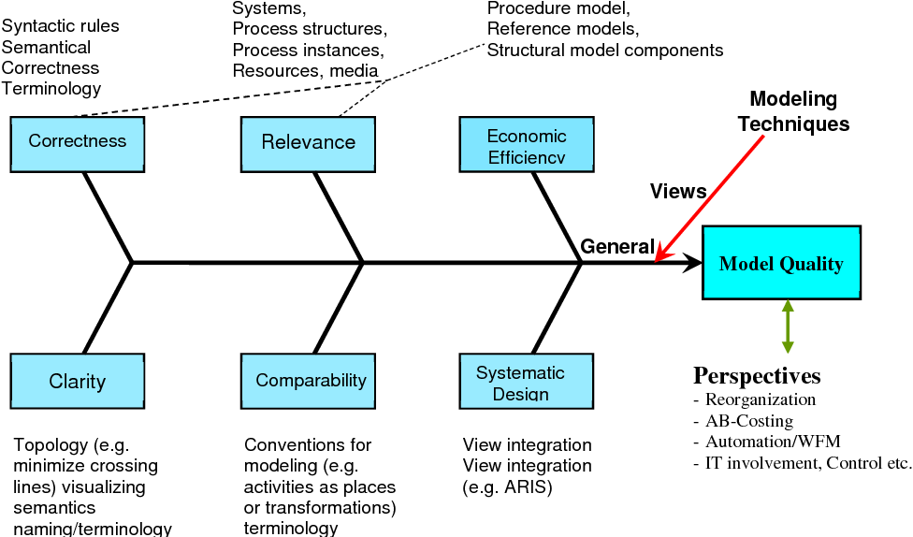

Slide 61
Impact Analysis
Impact analysis is the task of estimating the parts of the software that can be affected if a proposed change request is made.
Impact analysis techniques can be partitioned into two classes:
Traceability analysis In this approach the high-level artifacts such as requirements, design, code and test cases related to the feature to be changed are identified. A model of inter-artifacts such that each artifact in one level links to other artifacts is constructed, which helps to locate a pieces of design, code and test cases that need to be maintained.
Dependency (or source-code) analysis Dependency analysis attempt to assess the affects of change on semantic dependencies between program entities. This is achieved by identifying the syntactic dependencies that may signal the presence of such semantic dependencies.
The two dependency-based impact analysis techniques are: call graph based analysis and dependency graph based analysis.

Slide 62
Impact Analysis
Two additional notions related to impact analysis are very common among practitioners:
Ripple effect.
Change propagation.
Ripple effect analysis measures the impact, or how likely it is that a change to a particular module may cause problems in the rest of the program.
Measuring ripple effect can provide knowledge about the system as a whole through its evolution:
how much its complexity has increased or decreased since the previous version,
how complex individual parts of a system are in relation to other parts of the system, and
to look at the effect that a new module has on the complexity of a system as a whole when it is added.
The change propagation activity ensures that a change made in one component is propagated properly throughout the entire system.

Slide 63
Refactoring
Refactoring is the process of making a change to the internal structure of software to make it easier to understand and cheaper to modify without changing its observable behavior.
It is the object-oriented equivalent of restructuring.
Refactoring, which aims to improve the internal structure of the code, achieve through the removal of duplicate code, simplification, making code easier to understand, help to find defects and adding flexibility to program faster.
There are two aspects of the above definition:
It must preserve the “observable behavior” of the software system (through regression).
To improve the internal structure of a software system (improve maintainability).

Slide 64
Program Comprehension
Program understanding or comprehension is
“the task of building mental models of an underlying software system at various abstraction levels, ranging from models of the code itself to ones of the underlying application domain, for software maintenance, evolution and re-engineering purposes.”
A mental model describes a programmer’s mental representation of the program to be comprehended.
Program comprehension deals with the cognitive processes involved in constructing a mental model of the program.
A common element of such cognitive models is generating hypotheses and investigating whether they hold or must be rejected.
Hypotheses are a way to understand code in an incremental manner.
After some understanding of the code, the programmer forms a hypothesis and verifies it by reading code.
By continuously formulating new hypotheses and verifying them, the programmer understands more and more code and in increasing details.

Slide 65
Program Comprehension
Several strategies can be used to arrive at relevant hypotheses such as:
bottom up (starting from the code).
top down (starting from high-level goal).
opportunistic combinations of the two.
A strategy is formulated by identifying actions to achieve a goal.
Strategies guide two mechanisms, namely chunking and cross-referencing to produce higher-level abstraction structures.
Chunking creates new, higher level abstraction structures from lower level structures.
Cross-referencing means being able to make links elements of different abstraction levels.
Chunking and cross-referencing helps in building mental model of the program under study at different levels of abstractions.

Slide 66
Software Reuse
Software reuse was introduced by Dough McIlroy in his 1968 seminal paper:
The development of an industry of reusable source-code software components and the industrialization of the production of application software from off-the-shelf components.
Other significant early reuse research developments include:
Program families (David Parnas).
Domain analysis (Jim Neighbors).
Program families are sets of programs whose common properties are so extensive that it becomes advantageous to study the common properties of these programs before analyzing individual differences.
Whereas domain analysis is an activity of identifying objects and operations of a class of similar systems in a particular problem domain.

Slide 67
Software Reuse
Software reuse is using existing artifacts or software knowledge during the construction of a new software system.
Reusable assets can be either reusable artifacts or software knowledge.
Capers Jones identified four types of reusable artifacts:
data reuse, involving a standardization of data formats,
architectural reuse, which consists of standardizing a set of design and programming conventions dealing with the logical organization of software,
design reuse, for some common business applications, and
program reuse, which deals with reusing executable code.
Software reuse of previously written code is a way to increase
software development productivity.
quality of the software.
The cost savings during maintenance because of reuse are nearly 2x the corresponding savings during development.

Slide 68
Software Reuse
Reusability is a property of a software assets that indicates the degree to which it can be reused.
For software component to be reusable, it must exhibit the following characteristics that directly encourage its use is similar situation:
Environmental independence - The components can be reused irrespective of the environment from which they were originally captured.
High cohesion - The components that implement a single operation or set of related operations.
Loose coupling - The components that have minimal links to other components.
Adaptability - The components that are adaptable so they can be customized to fit a range of similar situation.
Understandability - The components which are easily understandable that users can quickly interpret functionality.
Reliability - The components that are error-free.
Portability - The components that are not restricted in terms of the software or hardware environment they operate in.

Slide 69
Software Reuse
Benefits of Reuse
Increased reliability.
Reduced process risk.
Increase productivity.
Standards compliance.
Accelerated development.
Improve maintainability.
Reduction in maintenance time and effort.

Slide 70
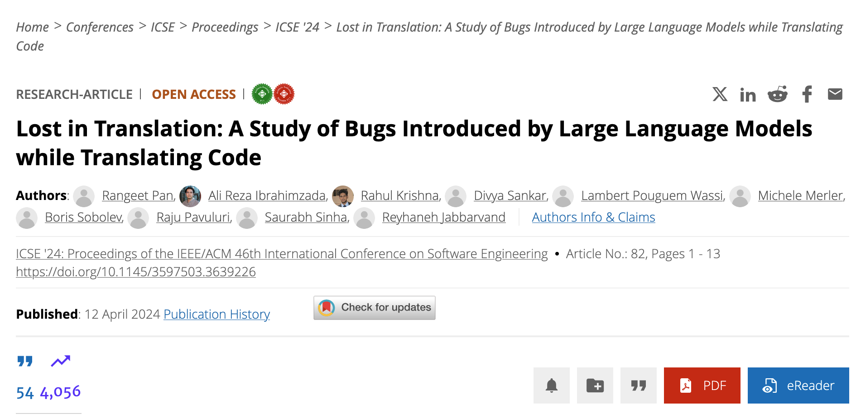
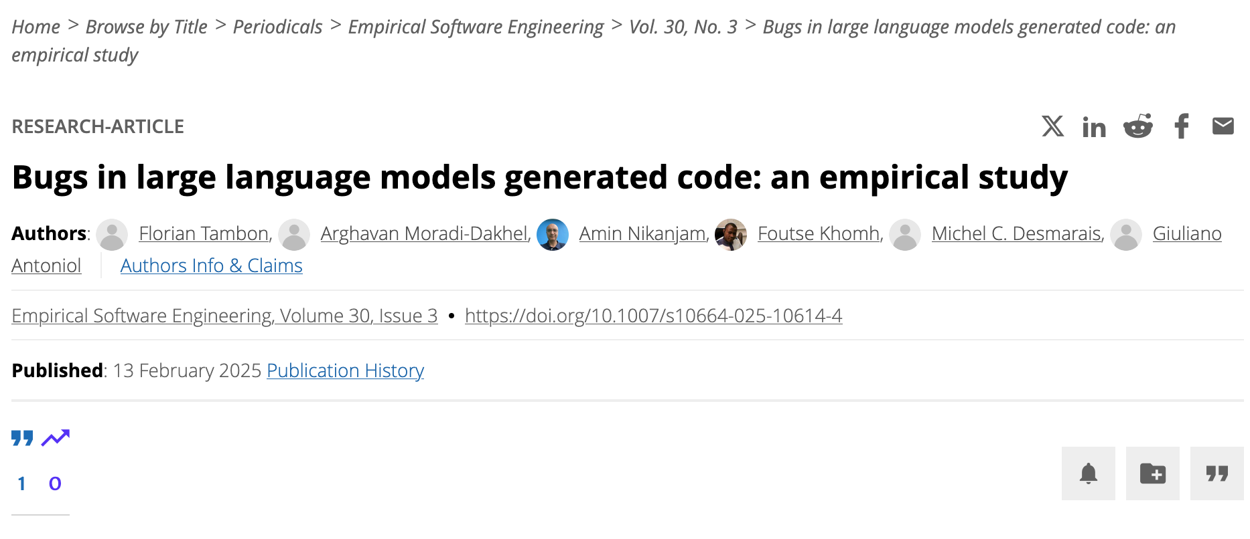
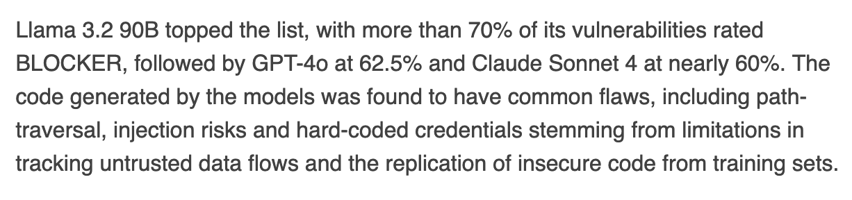
But why do we need all of this in the era of LLMs???
“correct translations [only] ranging from 2.1% to 47.3% for the studied LLMs.”
“10 bug patterns: Misinterpretations, Syntax Error, Silly Mistake, Prompt-biased code, Missing Corner Case, Wrong Input Type, Hallucinated Object, Wrong Attribute, Incomplete Generation, and Non-Prompted Consideration.”

Slide 71
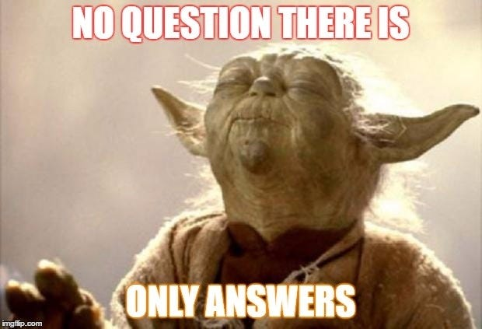
Questions?

